Slide 1
S&P 500 PREDICTION

Slide 2
Project Objective:
To forecast S&P 500 index using the following
Crude Price.
Gold Price.
Daily News Inflow
Indetify key factors that influence the S&P index.

Slide 3
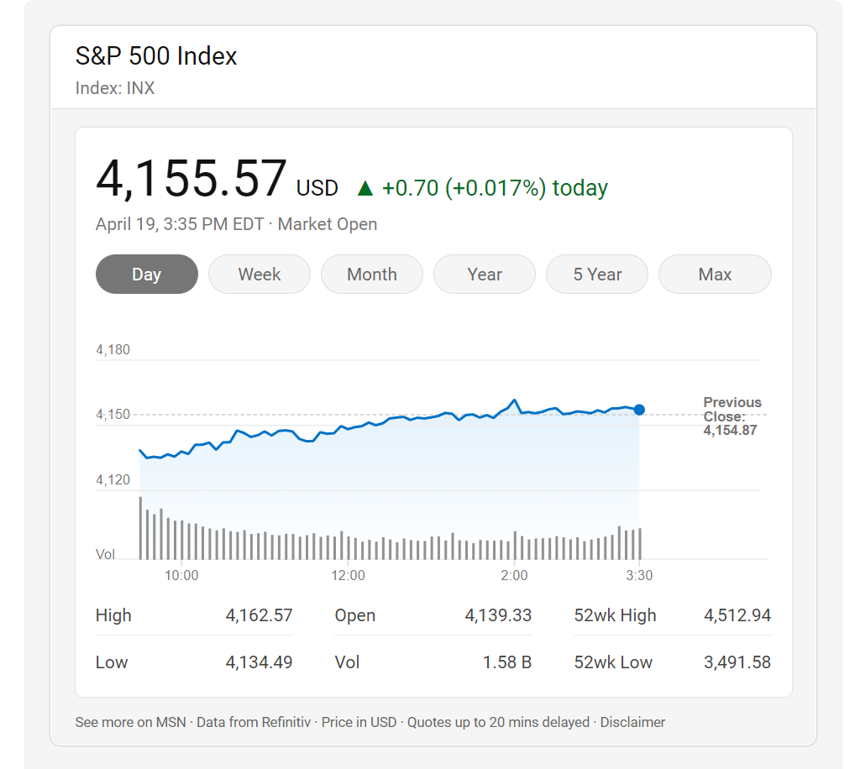
Background
The S&P 500, often known as the Standard and Poor's performance. It is a stock index that keeps track on the share prices of the 500 largest publicly owned American corporations.
The S&P 500 measures the value of large-cap U.S. stocks, or shares of businesses with a market value of at least $10 billion.
The S&P 500 is often used as benchmark for the performace of the US stock market.

Slide 4
Literature Review
Others Did
We Did
Used topic modelling to identify the news which causes
Study by Hyndman and Khandakar (2008) used an exponential smoothing model to forecast the S&P 500 index. The authors found that the model performed well in forecasting the index, particularly during periods of high volatility
Used Top news headlines to predict if the S&P 500 index will go up or down based on VaderSentiment and TextBlob sentiment analysis.
Used other major indicators like Crude price and Gold Price for the forecast.

Slide 5
Dataset
S&P 500 stock data from 8th Aug 2008 to 1st Jul 2016.
Top news headlines of the day during the same period.
S&P 500 Index: SPX | S&P 500 Index Historical Prices - WSJ
Gold Prices: Gold - 2023 Data - 1968-2022 Historical - 2024 Forecast - Price - Quote - Chart (tradingeconomics.com)
Crude Oil prices: Crude Oil Prices - 70 Year Historical Chart | MacroTrends
News Headlines: Stock Market News (reddit.com)

Slide 6
Data Description
Variable Name | Description
Date | Date
Gold Price | Closing price of Gold on that day
Crude Price | Closing price of Crude on that day
News Inflow | News inflow on that day
S&P Index Price | Closing stock price of S&P 500 on that day

Slide 7
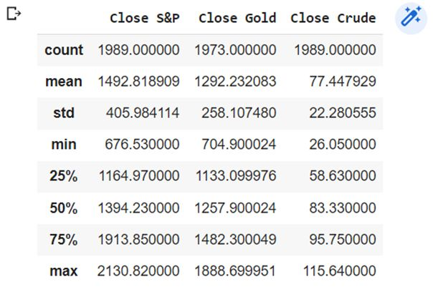
Data Description

Slide 8
Approach
Data Preprocessing
Data Exploration
Predictive Models
Findings and Insights
Model Evaluation and Selection

Slide 9
Data PreProcessing STEPS
Tokenization
Breaking down complex sentence into words
Remove punctuation
Ex: ‘,’ , ‘@’ etc
Reduced words to base form
Lemmatization
Removed stop words along
Word Filtration
Remove byte character
b’ and b”
Convert into lower case

Slide 10
Data preprocessing(Transformation)
To make the time series continuous
inserted missing dates for the whole range
Introduced a binary variable ‘Label’(based on S&P 500 close price)
0 if the index decreses from with respect to previous day
1 if the index remains same or increses with repect to previous day
New Variable : ‘percent_change’ in index from previous day

Slide 11
Data preprocessing
Sentiment Analysis:
Polarity: Positive, Negative and Neutral sentiment from VaderSentiment library
Polarity(-1 to +1) Extracted using TextBlob library
Subjectivity: Measure of how subjective a document is ( 0 to 1)

Slide 12
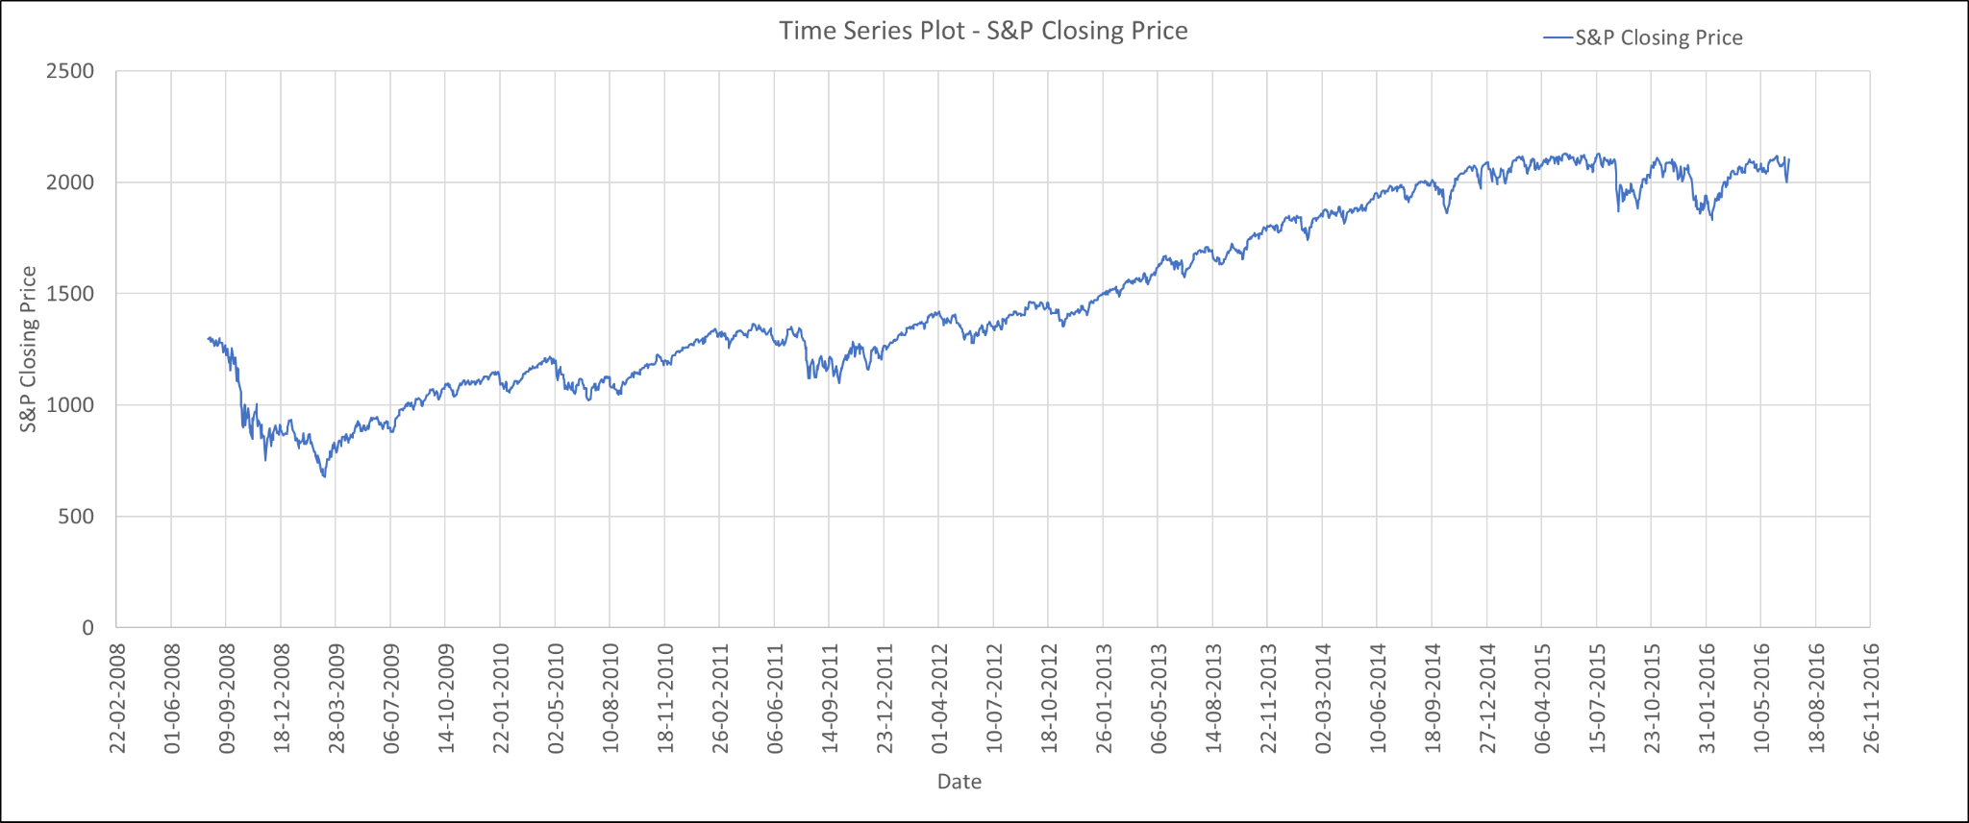
Data Exploration

Slide 13
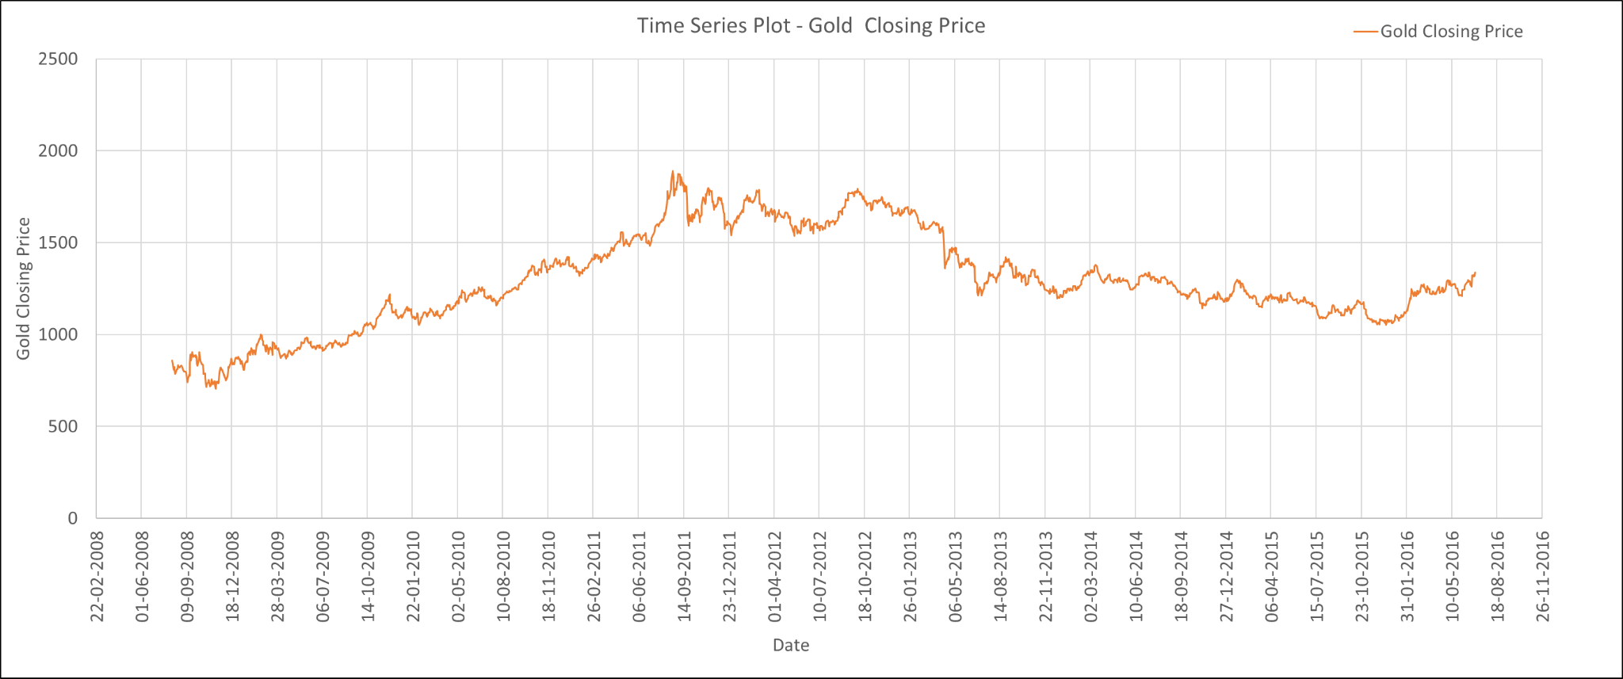
Data Exploration

Slide 14
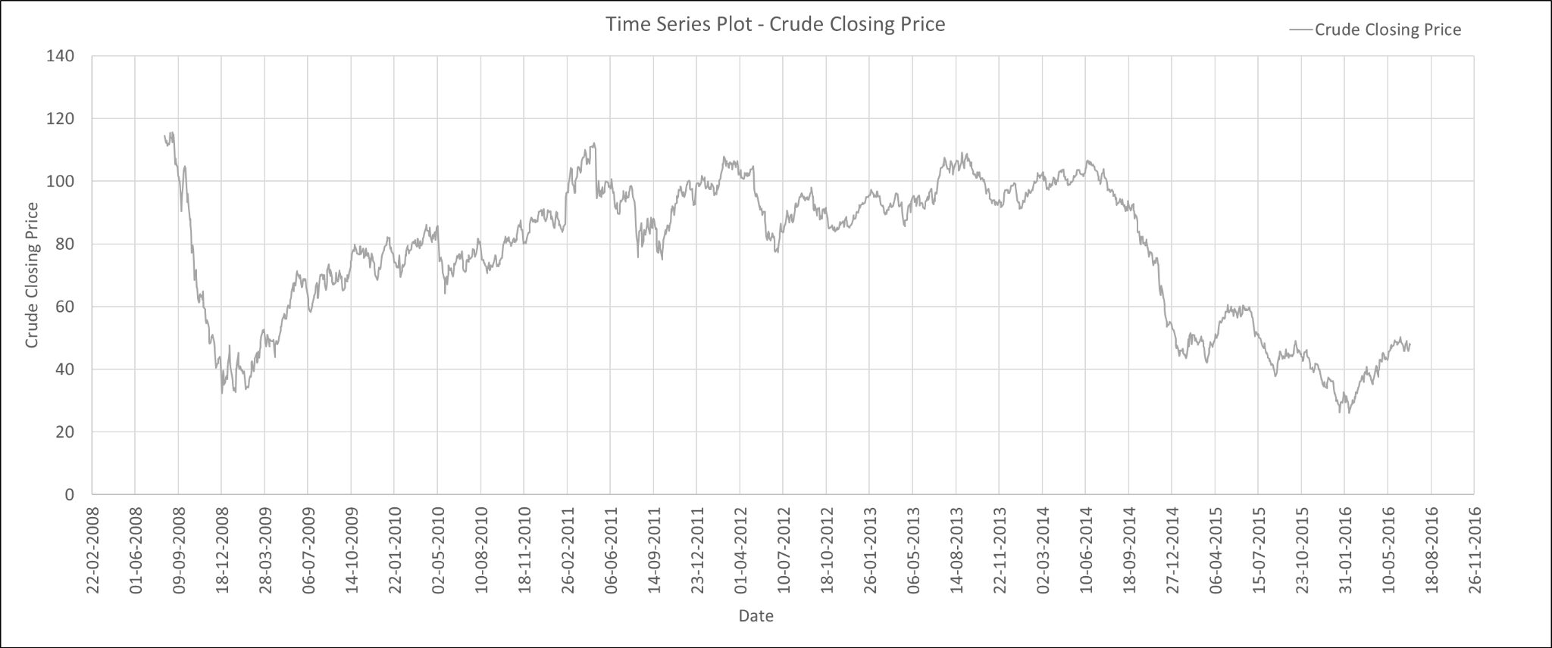
Data EXPLOration

Slide 15
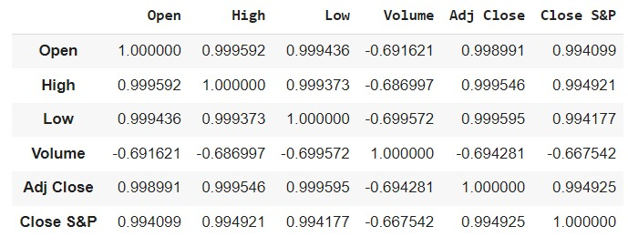
Data Exploration – Correlation

Slide 16
Modeling

Slide 17
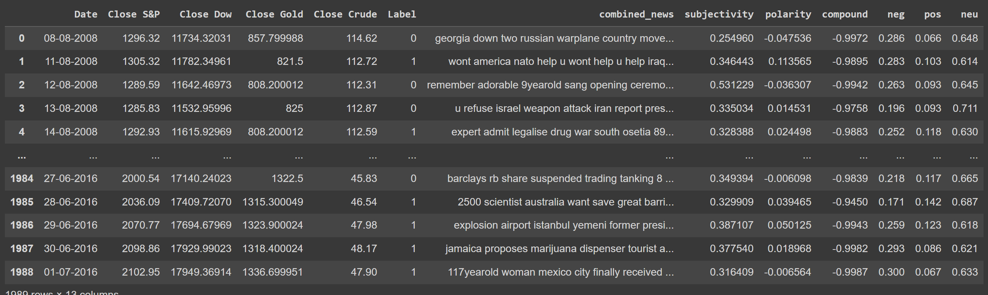
Modeling – Text mining

Slide 18
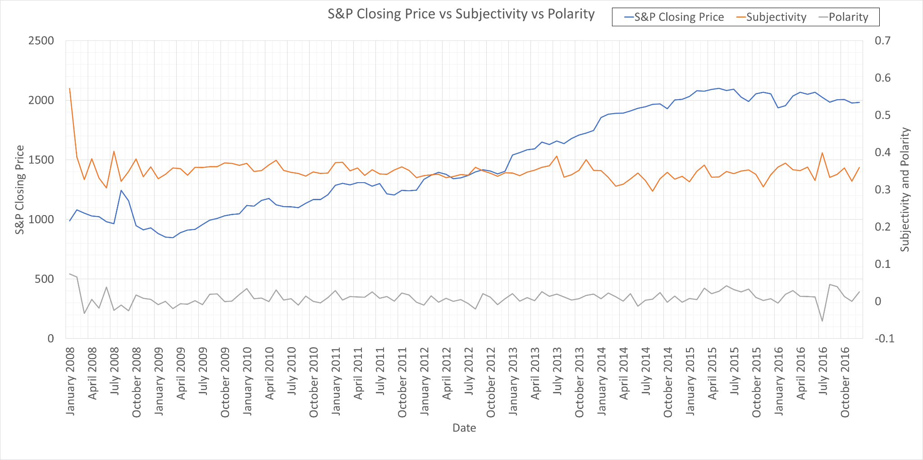
Modeling – Text mining

Slide 19
Modelling – text mining

Slide 20
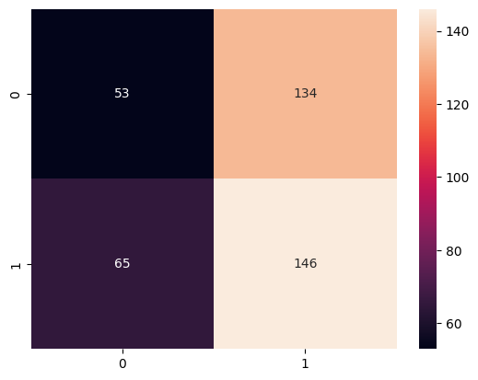
Modelling – text mining
Gradient Boosting Classifier
Confusion Matrix

Slide 21
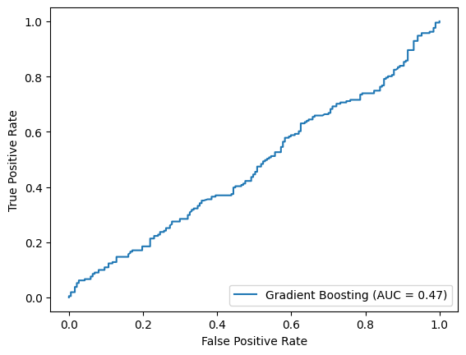
Modelling – text mining
Gradient Boosting Classifier
ROC Curve

Slide 22
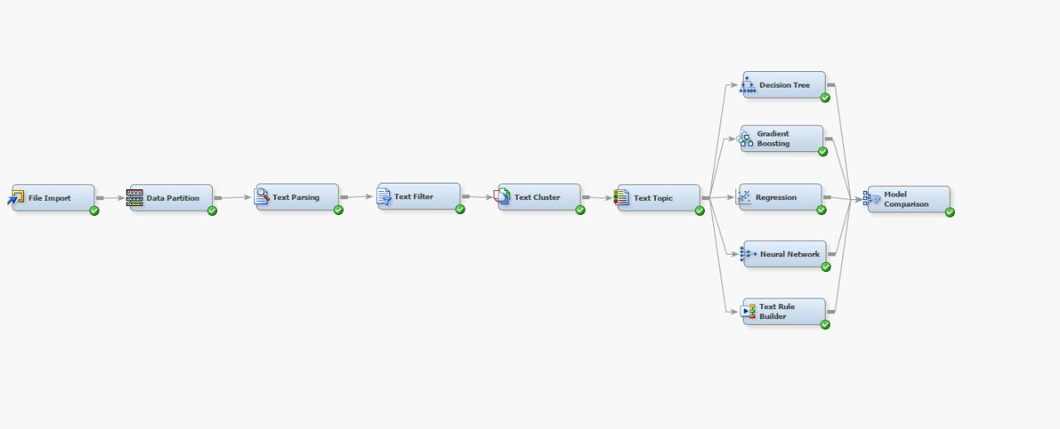
Modelling – text mining

Slide 23
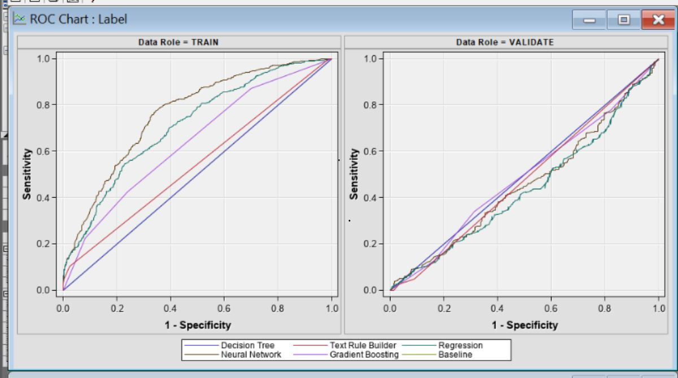
Modelling – text mining

Slide 24
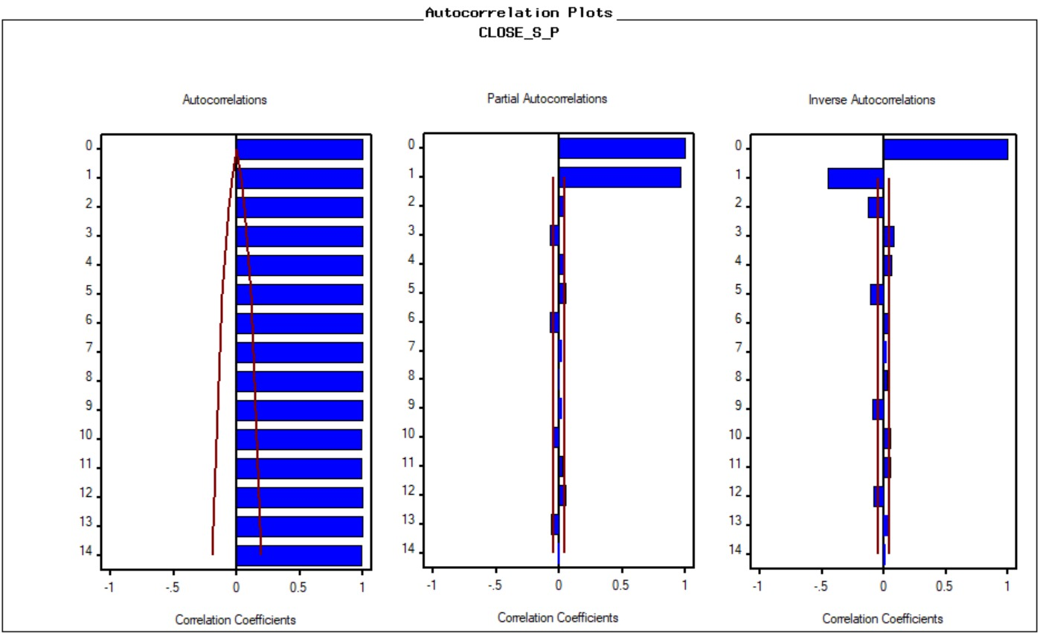
Modeling
On raw data

Slide 25
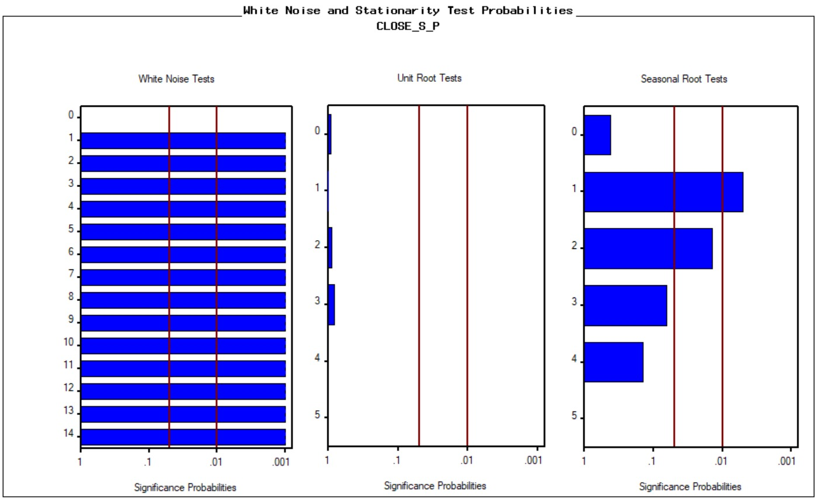
Modeling
On raw data
There is clear Trend
Seasonality is not strong.
Not White Noise

Slide 26
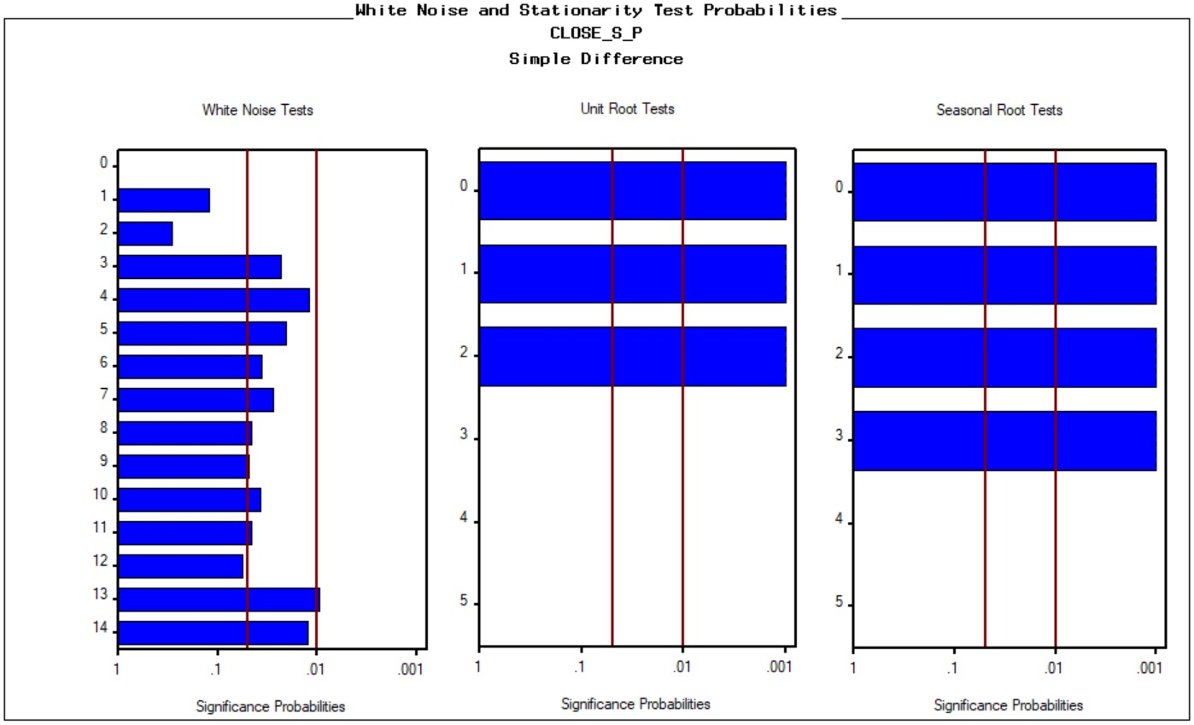
Modeling
After first simple difference

Slide 27
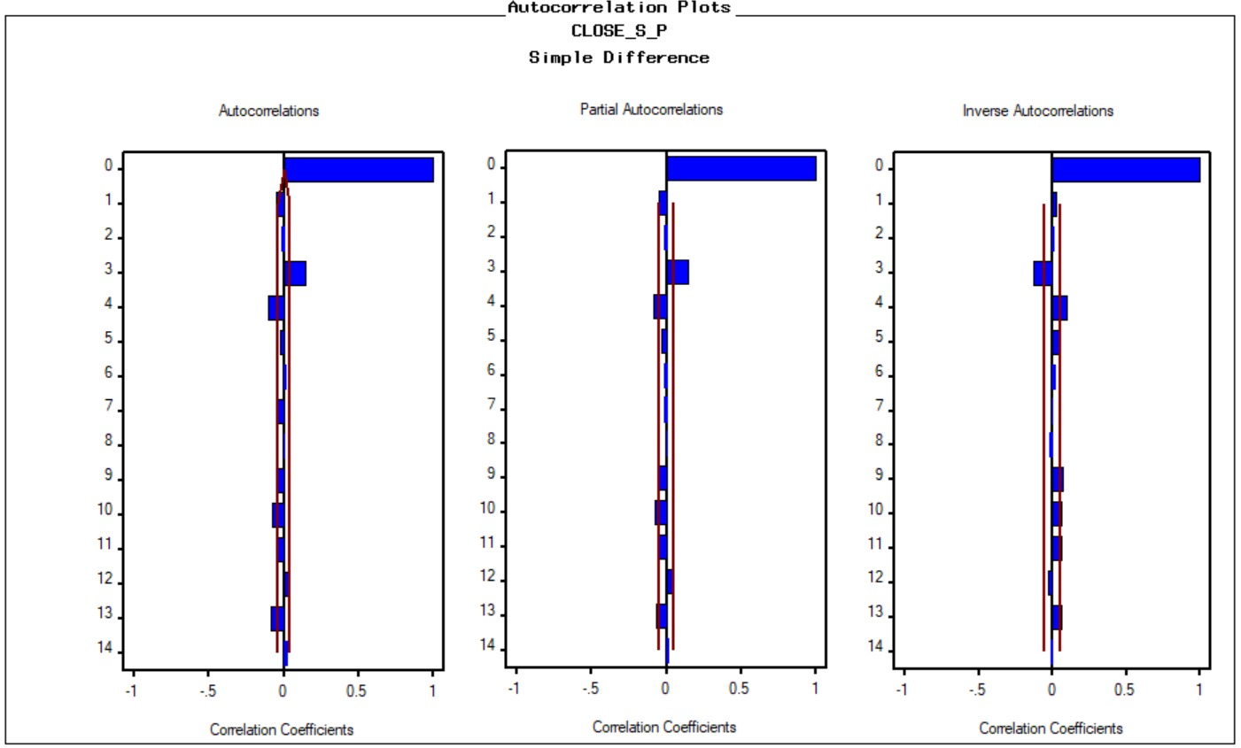
Modeling
After first simple difference

Slide 28
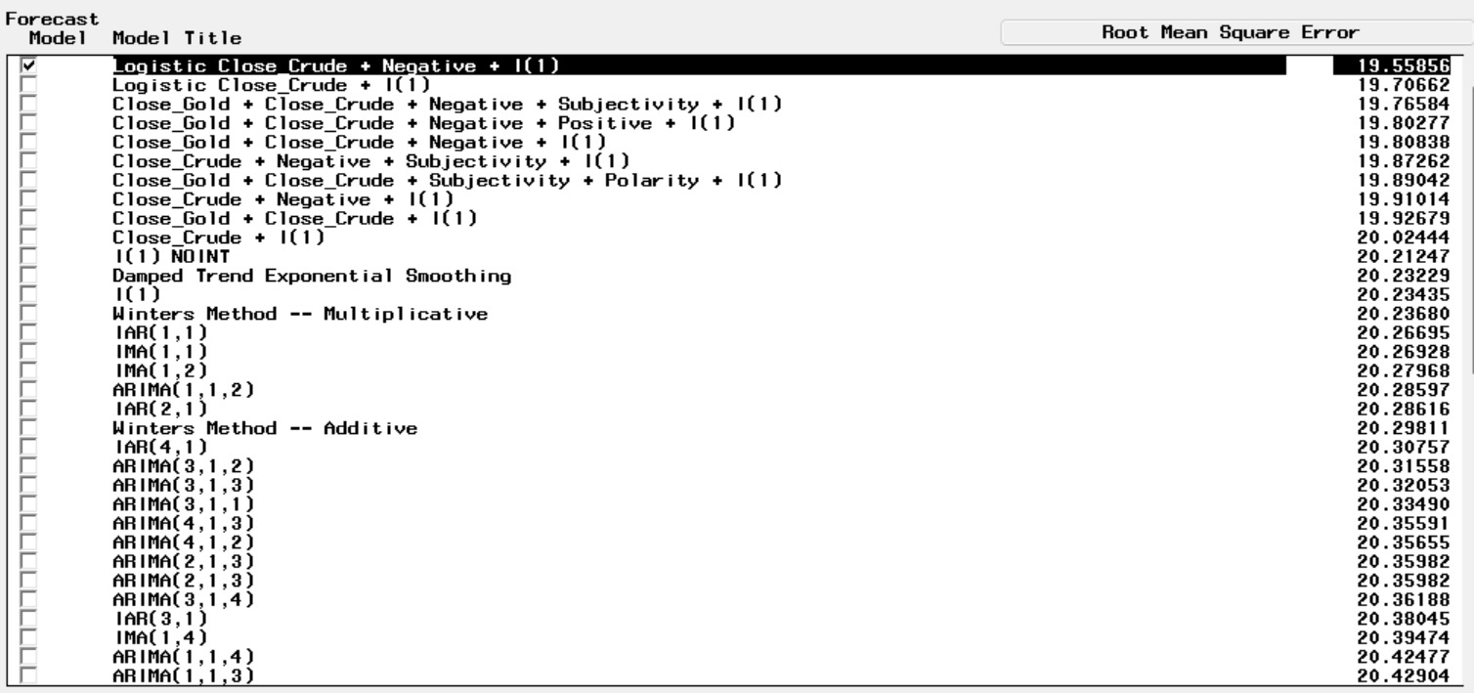
MODELS DEVELOPED

Slide 29
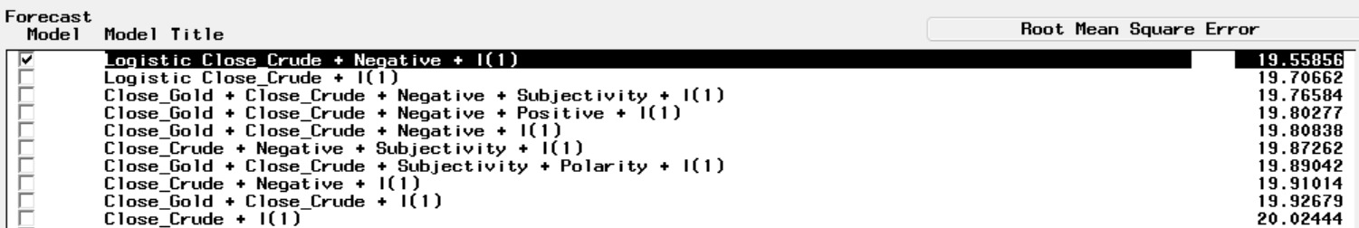
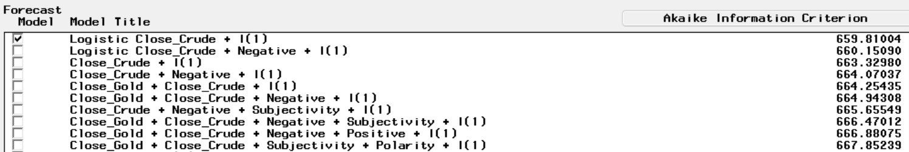
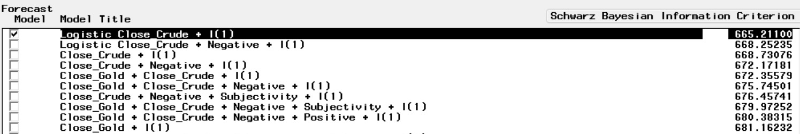
Performance evaluation
RMSE
AIC
BIC

Slide 30
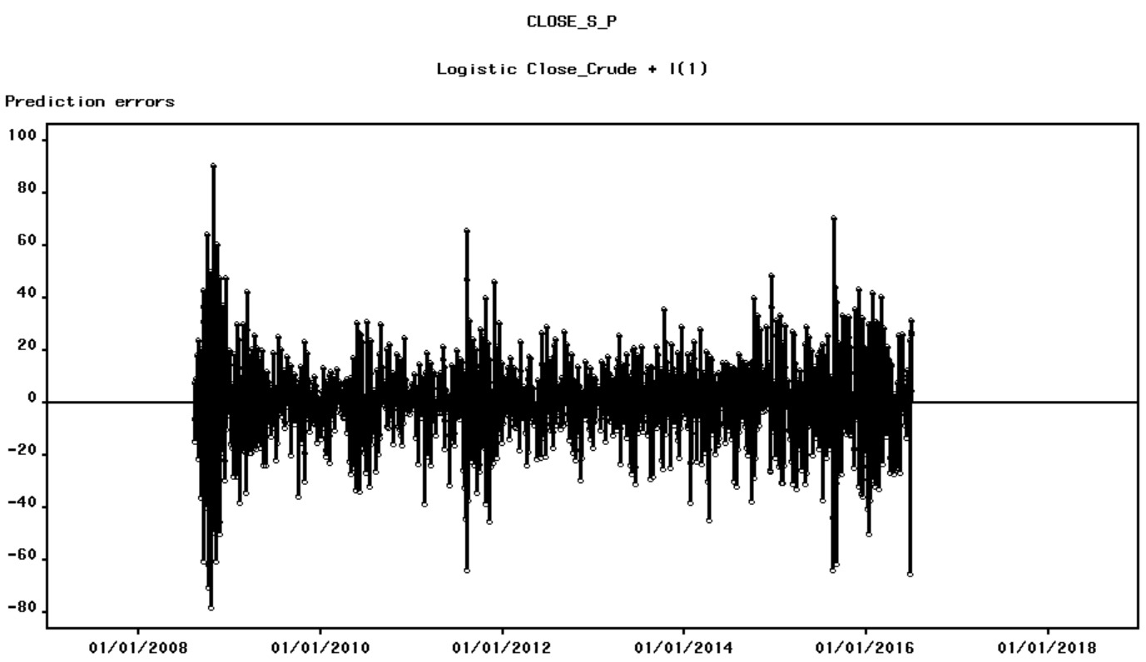
Performance evaluation
Residuals

Slide 31
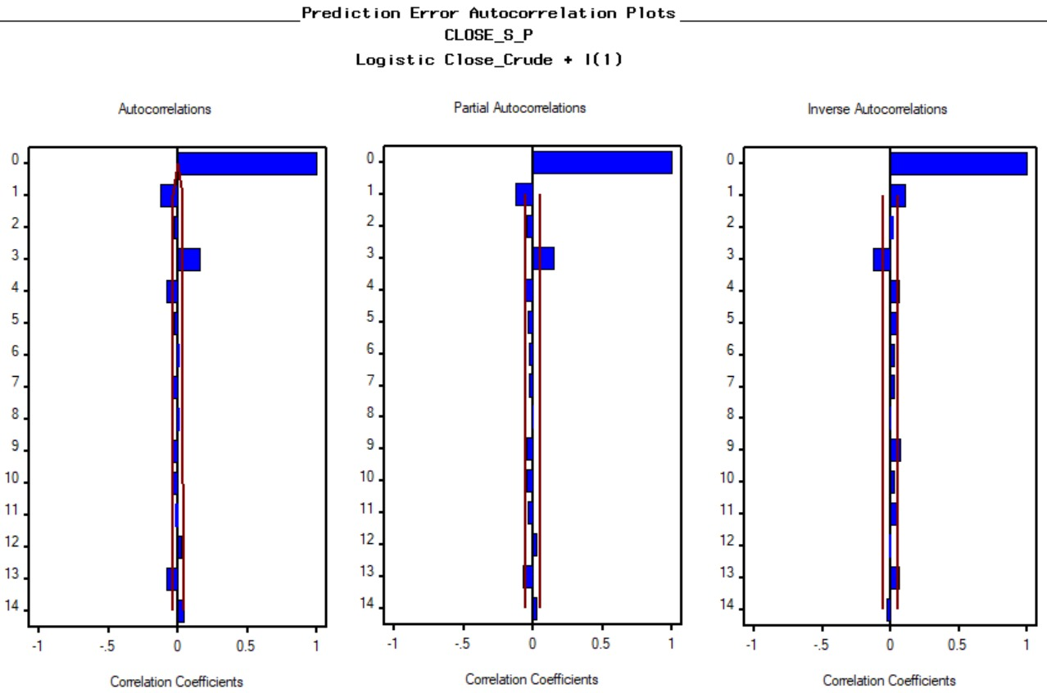
Performance evaluation
Residuals

Slide 32
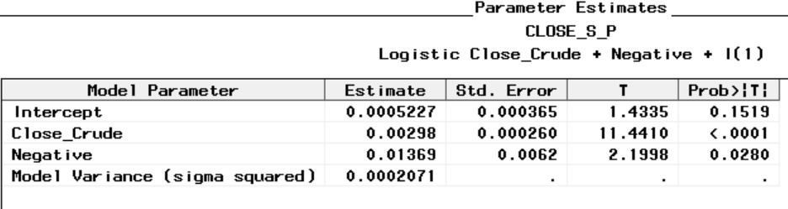
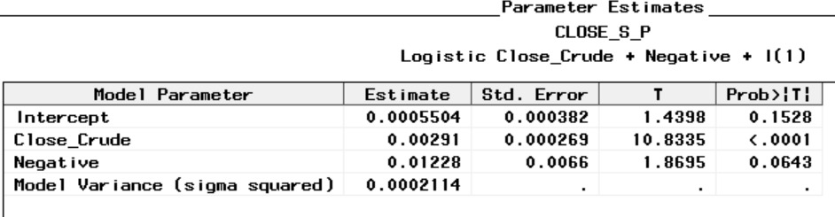
Performance evaluation
Parameter Estimates
Without Hold-out Sample
Parameter Estimates
With Hold-out Sample

Slide 33
findings and Insights

Slide 34

Word cloud for label = 1

Slide 35

Word cloud for label = 0

Slide 36
findings and Insights
S&P 500 index is highly dependent on Crude price.
Negative news inflow has significant impact on S&P 500 index.
Volume of trades has strong negative impact on S&P 500 index.
Gold price doesn’t seem to affect S&P 500 index.
There is a very strong upward trend in S&P 500 index, but seasonality doesn’t seem to exist.

